Slide 1
Shape Object
CGCII
Cho sanghyun’s Game Classes II
All Right Reserved ©SD Labs

Slide 2
 CONTENTS
CGCII
Cho sanghyun’s Game Classes II
ASE Parsing이란?
ASE File의 구조
Geo Object
좌표계의 차이
  좌표
  Cull Mode
  Texture
Mesh의 구조
  Face Normal과 Vertex Normal
  Normal Parsing
  Normal 추출의 문제점
Lexer와 Parser
질문?
실습
All Right Reserved ©SD Labs

Slide 3
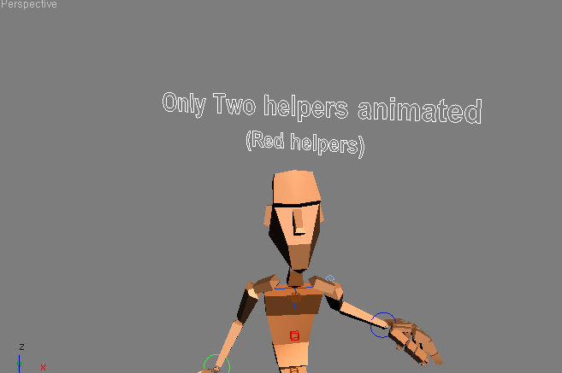
 Shape Object란?
CGCII
Cho sanghyun’s Game Classes II
GeoObject가 Mesh를 Export한 것이라면 Shape Object는 Line을 Export한 것이다.
이런 Line
이런 Line
All Right Reserved ©SD Labs

Slide 4
 Sehape Object의 구조
CGCII
Cho sanghyun’s Game Classes II
기본적인 형태는 GeoObject와 동일하다 단지 Mesh대신 Line의 List만이 있을 뿐이다.
*SHAPEOBJECT {
*NODE_NAME "Boped_help_L_look_Arm"
*NODE_PARENT "Boped_help_L_look_Arm_rot"
*NODE_TM {
*NODE_NAME "Boped_help_L_look_Arm"
*INHERIT_POS 0 0 0
*INHERIT_ROT 0 0 0
*INHERIT_SCL 0 0 0
*TM_ROW0 -0.11636715 -0.01782141 -0.61781430
*TM_ROW1 -0.61567712 -0.05194070 0.11746283
*TM_ROW2 0.05435117 -0.62652868 0.00783546
*TM_ROW3 -41.76874542 -83.79934692 555.42535400
*TM_POS -41.76874542 -83.79934692 555.42535400
*TM_ROTAXIS 0.63732076 0.57579297 0.51213735
*TM_ROTANGLE 1.95241630
*TM_SCALE 0.62893033 0.62893057 0.62893051
*TM_SCALEAXIS 0.73776847 -0.66583836 0.11116166
*TM_SCALEAXISANG 0.69168955
}
*SHAPE_LINECOUNT 2
*SHAPE_LINE 0 {
*SHAPE_CLOSED
*SHAPE_VERTEXCOUNT 4
*SHAPE_VERTEX_KNOT 0 -42.56403732 -83.85951996 556.39831543
*SHAPE_VERTEX_KNOT 1 -40.79425430 -83.83544159 556.22027588
*SHAPE_VERTEX_KNOT 2 -40.97296143 -83.78558350 554.45104980
*SHAPE_VERTEX_KNOT 3 -42.74274445 -83.80966187 554.62915039
}
*SHAPE_LINE 1 {
*SHAPE_VERTEXCOUNT 2
*SHAPE_VERTEX_KNOT 0 -41.64174271 -85.22902679 555.34136963
*SHAPE_VERTEX_KNOT 1 -41.73718643 -82.36576843 555.43371582
}
}
SHAPE_LINE의 개수.
SHAPE_LINE임.
All Right Reserved ©SD Labs

Slide 5
 Key Frame Animation
CGCII
Cho sanghyun’s Game Classes II
KNOT
INTERP
INTERP
KNOT
*SHAPE_LINECOUNT 2
*SHAPE_LINE 0 {
*SHAPE_CLOSED
*SHAPE_VERTEXCOUNT 4
*SHAPE_VERTEX_KNOT 0 -42.56403732 -83.85951996 556.39831543
*SHAPE_VERTEX_INTERP 1 -40.79425430 -83.83544159 556.22027588
*SHAPE_VERTEX_INTERP 2 -40.97296143 -83.78558350 554.45104980
*SHAPE_VERTEX_KNOT 3 -42.74274445 -83.80966187 554.62915039
}
X
Z
Y
KNOT과 INTERP는 기본적으로 같다.
KNOT은 제어점으로 고정된 점.
INTERP는 제어점 간을 보간한 점
All Right Reserved ©SD Labs

Slide 6
 Key Frame Animation
CGCII
Cho sanghyun’s Game Classes II
INTERP
INTERP
처음과 끝을 연결해준다.
Closed이면 제일 마음과 처음을 연결해준다.
*SHAPE_LINECOUNT 2
*SHAPE_LINE 0 {
*SHAPE_CLOSED
*SHAPE_VERTEXCOUNT 4
*SHAPE_VERTEX_KNOT 0 -42.56403732 -83.85951996 556.39831543
*SHAPE_VERTEX_INTERP 1 -40.79425430 -83.83544159 556.22027588
*SHAPE_VERTEX_INTERP 2 -40.97296143 -83.78558350 554.45104980
*SHAPE_VERTEX_KNOT 3 -42.74274445 -83.80966187 554.62915039
}
All Right Reserved ©SD Labs

Slide 7
☑ 질문?
CGCII
Cho sanghyun’s Game Classes II
All Right Reserved ©SD Labs

Slide 8
☑ 실습
CGCII
Cho sanghyun’s Game Classes II
Level 1)
Shape Object Parsing해서 출력해보기.
All Right Reserved ©SD Labs

